Slide 1
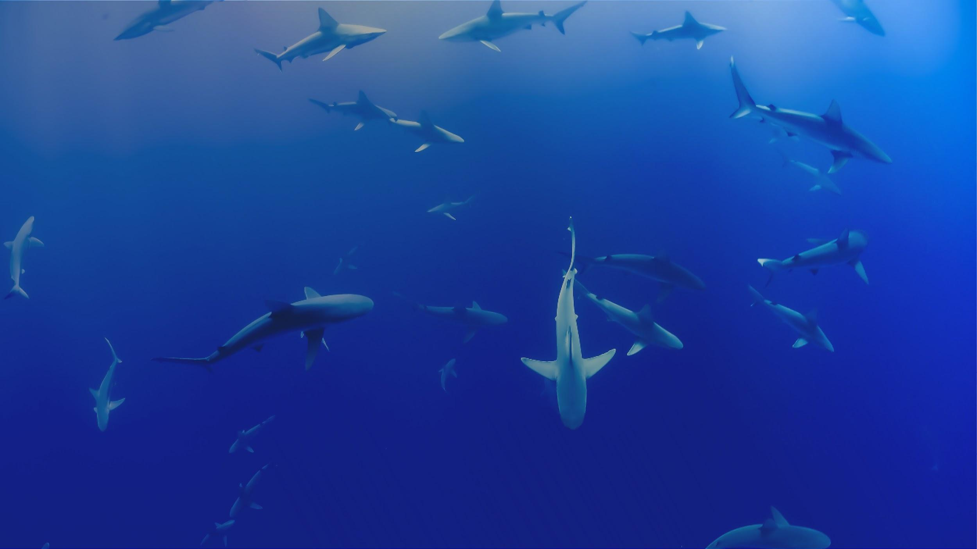

Winter 2020 Update
Naomi Tress – Data Acquisition Coordinator
Notes:
Hi, my name’s Naomi Tress, and I’m here to give an update on how things have been going at the OTN, since the last meeting. In the last year, we have been able to double up nearly all of the positions in the data team. This has meant more training, more tools and support, and more telemetry data being processed and matched.

Slide 2

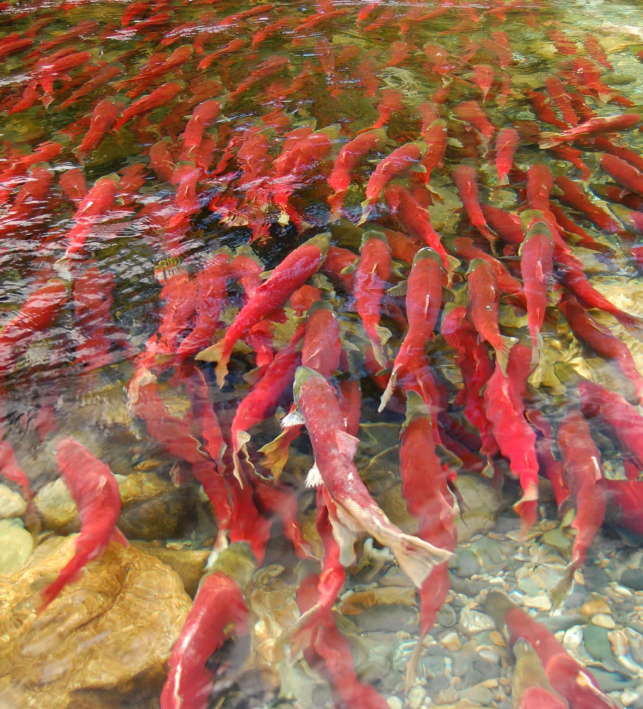

BETTER TOGETHER
The past while has been different, but we have been busy!
OTN continues to work ,making it easier to share data with your neighbouring telemetry projects, and with researchers a world away.
Sharing resources, abilities, not just data through training, equipment loans and data management support.
OCEAN TRACKING NETWORK
Notes:
The OTN is funded by the Canadian Centre for Innovation, Major Science Initiative, on an auto-renewed 5 year cycle.
It is OTNs mandate, based on our funding, to connect and empower researchers using tracking technologies to deliver insight into their study species around the world.
OTN keeps making connections, and strengthening the ones we’ve had now for years. Both our international and smaller scale presence is helping more and more researchers with the work they do, connecting with other researchers, justifying themselves to funding bodies, perfecting skills beyond the fishing and tagging that you all do so well.
Under the framework of our funding, OTN is meant to provide ‘infrastructure support’.
We get this done in a few ways. OTN maintains a set of core acoustic telemetry receiver lines around the world, some 800 or so receivers on every coast of Canada including in the Great Lakes, maintained by our field team, that researchers can leverage and rely on when designing their own studies.
We help innovate new ways to attach listening equipment to mobile platforms like our Slocum and Wave Gliders, and more recently to ocean physics drifters, and lower the engineering costs for new research projects to adopt those techniques.
We’ve rolled out an ROV shop, the gear is great for habitat characterization, mooring recovery, active tracking, and visual surveying. We have the inhouse expertise to advise on any of these areas now.
Our newest tool is a Side Scan Sonar, work with this is ramping up, doing habitat surveys, assisting in locating abandoned or lost ‘ghost fishing gear’
The part we show off the most to the FACT group is our data shop, aggregating the data that’s reported to OTN from individual projects, labs, institutes, citizen science programmes, using any or all of these technologies, performing cross-network matching of detections to tagged animals, and reporting that data to the reseachers who deployed the tags.
Researchers can take their network-wide detection extracts, which are in a nice tabular data format, and use them as the input into community-built open source telemetry analysis software like glatos, VTrack, and Resonate.

Slide 3
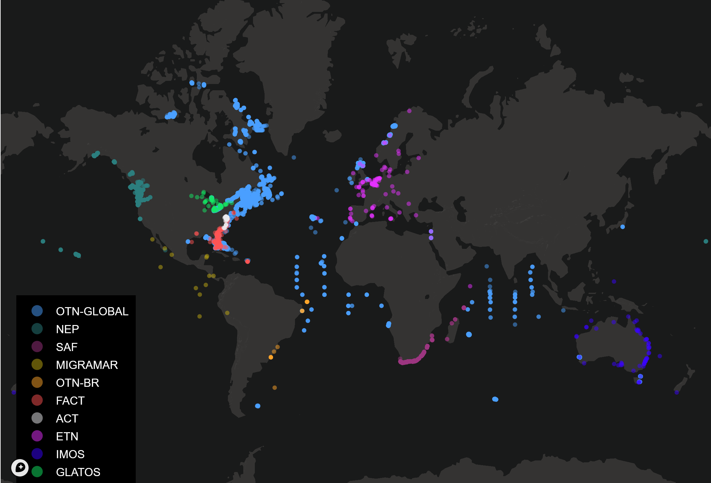
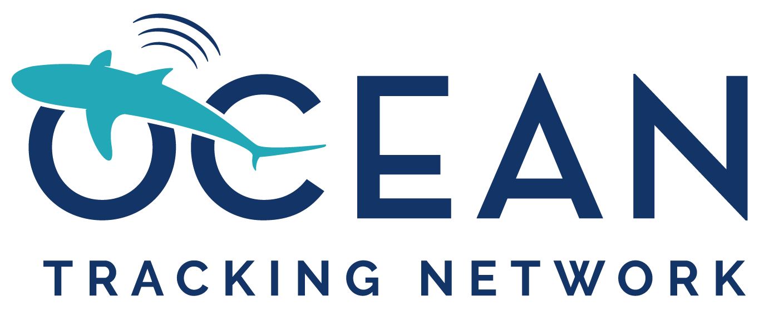
OTN-Global and OTN Nodes
OTN Global + Northeast Pacific
395 projects , 930 collaborators representing 60,000+ individual tagged animals
OTN Nodes and Partners:
+262 projects and 200 partnered collaborators. managed via nodes
+200 projects held by data partners
OCEAN TRACKING NETWORK
Notes:
Here you can see the reach of all these networks, both nodes and partners we’ve built crosswalks to.
Somebody once told me that fish move, and at OTN we do our best to ensure researchers are able to track all of that action.
In addition to sharing detections between disparate groups that rub shoulders with each other, this global coverage allows for large pelagics to be studied, as well as comparison studies between similar habitats.
Represented on this map are OTNs almost 400 projects, and over 900 collaborators
This is added to by the OTN nodes and partners, over 250 more projects, 200 collaborators in the OTN style nodes, and 200 or more projects in the hands of our partners.
All to the tune of 300 million acoustic animal detections as of this last push!

Slide 4
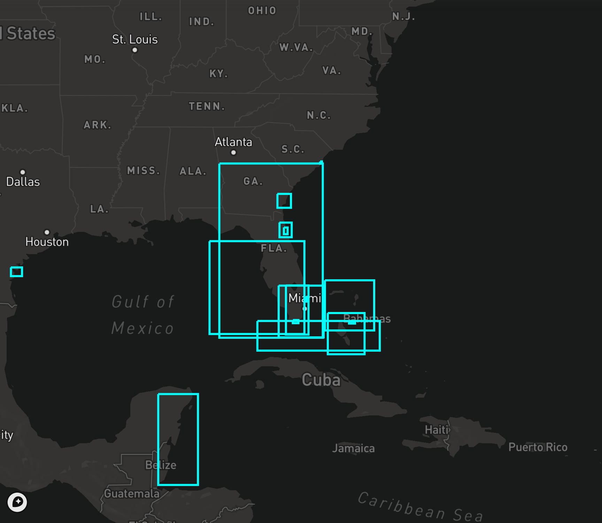
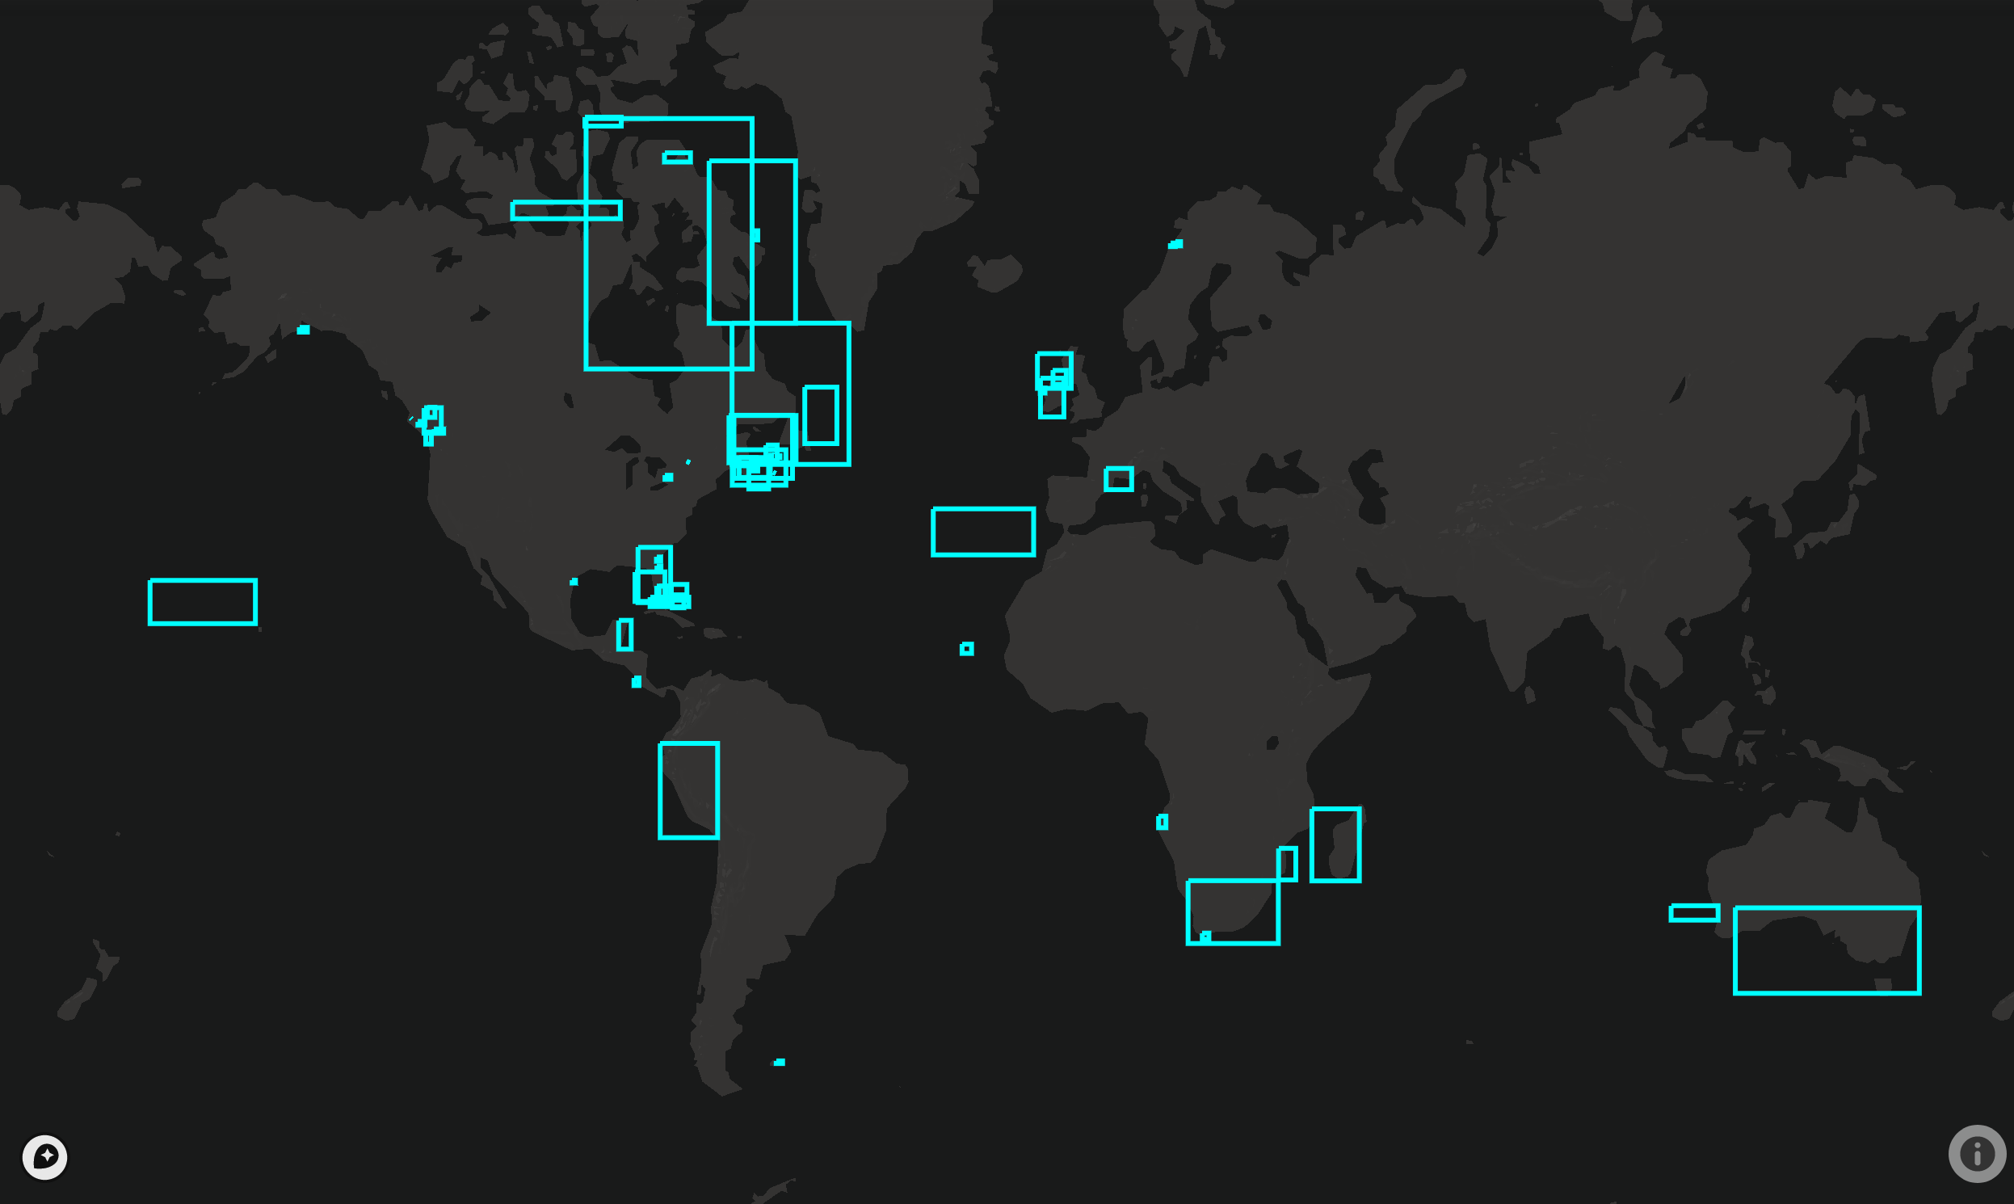
Partnerships and Collaborations
So many people in the neighbourhood
OTN continues to support FACT projects through loans of varying sizes.
Allows projects to leverage other funding sources
Data immediately compatible with all other FACT projects
Equipment loans available in the spring, apply now!
Detections get matched across all other compatible nodes, also unmatched if researcher says they dont make temporospatial sense
OCEAN TRACKING NETWORK
Notes:
OTN has had great success with our equipment loan program, sharing resources to build the infrastructure network around the globe
Closer to home, there are numerous current and past projects in the FACT region, and adjacent, directly supported by OTN loans
These loans range from small, less than 10 receivers, to very large, over 100 receivers. Most common these days are loans in the 5-15 receiver range. This allows projects to leverage other funding sources, run proof of concept studies, and expand pre-existing infrastructure.
The data and metadata expected from one of these loans is immediately compatible with all other FACT projects.
There is current availability for loans, after the application process is completed, OTN is creating a pool of equipment earmarked for FACT, and this spring should see even more equipment available. If you are in the planning stages of your projects, and want to apply, we will be able to tell you if we have gear available on your project’s timeline.

Slide 5
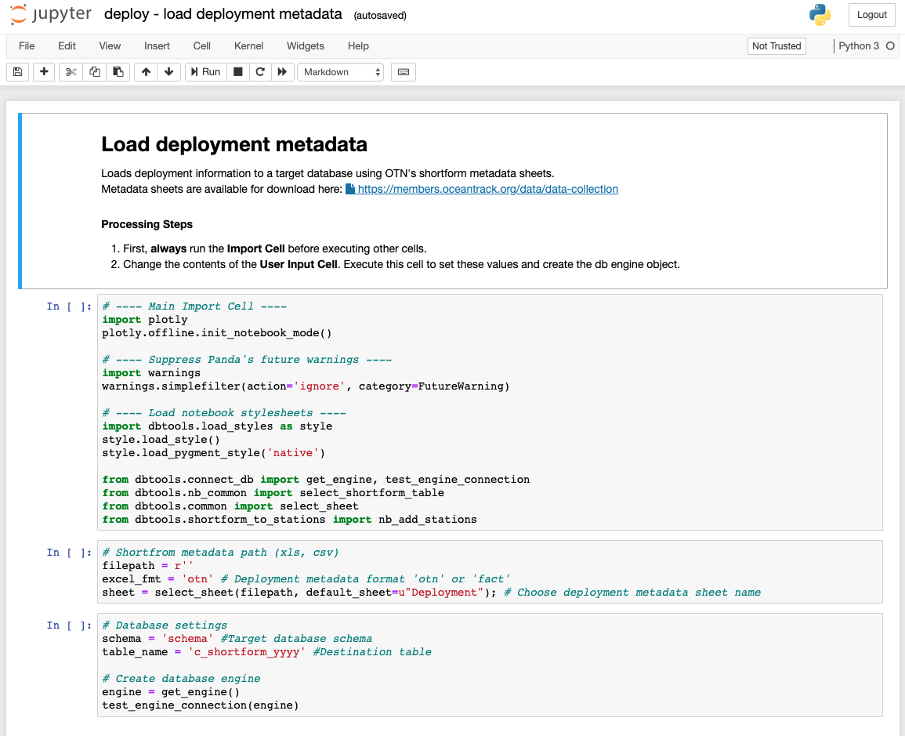
OTNDC software development and more
A overview of actively developed tools at OTNDC
Ipython-utilities, tools for managing the OTN DB Node
glatos - R package, Acoustic Telemetry Analysis in collaboration with GLATOS
resonATe, Python version of the glatos package
OBIS ENV dataset creation tool, Allows a node database to publish animal tracking data to OBIS/GBIF
Training curriculums for telemetry at https://github.com/ocean-tracking-network
OCEAN TRACKING NETWORK
Notes:
The software that we maintain at OTNDC to both keep ourselves doing this work in a uniform way and sharing what we learn to our node partners,
This includes our OTN developed data management software package (ipython-utilities), analysis and visualization packages like glatos and its Pythonic twin, Resonate. and the scripts that knock datasets into the OBIS ENV format.
Many of you are coming to the workshops tomorrow and thursday, these are a new and important part of the OTN data centre’s work
We have been busy helping teach basic coding skills, teaching acoustic telemetry to new practitioners as well as maintaining a core set of lessons on our GitHub page.

Slide 6
Training, Support and Sanity!
Before March: Node Managers, OBIS training, undergraduate and early carrer training.
Ongoing Training and Support for Telemeters
Currently running a weekly ‘study hall’, group trouble shooting of analysis issues, global agregation of telemetry analysts.
If you need advice or company while you ponder, here is where that can happen.
OCEAN TRACKING NETWORK
Notes:
Expanding partnerships led to a training effort for new Node Managers, individuals identified by their organization for the combined role of data acquisition, data management and analysis. Node managers were trained and we provide continual support to their efforts. The OTN data system can be stood up very efficiently, so our training is completed on a dummy verision that is an exact replica of what node managers will be working on. This is also how we share our data system so readily with partners, once they have a node manager identified, and somewhere to store thier data system, the process is near instantaneous. We’re going to run another training session in 2020, probably late in the year again, where we’re hoping to get reps from SAF, OTN Brazil, and another MigraMar member in to get certified.
Based on the data Carpentries curriculum, we have been advancing the skills of very-early career biologists, training in 1-2 hour sessions on Python and R coding skills, focusing on the aspects that biologist and other life-scientist will need.
OTN supports the glatos package of telemetry analysis tools, as well as methods for translating into other telemetry analysis tools such as v-track. We assist researchers with dispersing their custom tools to others in their field.
As a way to keep everyone involved and put our heads together on coding problems, OTNDC has been hosting weekly ‘Study Halls’, we have hosted over 30 of these, and had attendees from as far away as Kazakstan!

Slide 7

OTN IN NUMBERS
68,283
61
313
300 M
INDIVIDUAL ANIMALS TRACKED
COUNTRIES
SPECIES TRACKED
GLOBALLY
GEOLOCATED ANIMAL DETECTIONS
OTNDC@DAL.CA
Evelien.VanderKloet@Dal.Ca
OCEAN TRACKING NETWORK
Notes:
We at OTN are currently connecting the information submitted by over 800 scientists tracking 68,283 animals across 313 species and 61 countries. We’re holdingover 300 million animal detections as seen on over 20k instrument deployments over the past 15 years.
If youre interested in information about our study halls, or other training opportunities, email otndc. If you want more information about our loaner program, you can email otndc, or go straight to the source by emailing evelien vaderkloet.

